Slide 1

Langchain in 60 minutes
Pradeep Kumar

Slide 2
In this session
Why Langchain
AI Chatbot
Prompts & LLMs
Simplify Prompts with PromptTemplate
Tools
Adding Weather Capabilities using Tools
Remember with ConversationBufferMemory
Memory
Observability
Monitor
using
LangSmith
Deployment
Deploy using LangServe
Notes:
How presentation will benefit audience: Adult learners are more interested in a subject if they know how or why it is important to them.
Presenter’s level of expertise in the subject: Briefly state your credentials in this area, or explain why participants should listen to you.

Slide 3

Imagine: Your friend is travelling to Dubai
Notes:
Lesson descriptions should be brief.

Slide 4
Let’s help your friend
We will create AI chatbot
So that
Ask questions
Create itineraries
General advise
Notes:
Example objectives
At the end of this lesson, you will be able to:
Save files to the team Web server.
Move files to different locations on the team Web server.
Share files on the team Web server.

Slide 5
Let’s code
Version 1
Notes:
Example objectives
At the end of this lesson, you will be able to:
Save files to the team Web server.
Move files to different locations on the team Web server.
Share files on the team Web server.

Slide 6
Can we improve?
What if we changed the LLM?
Unified Interface to LLMs
Better way to manage Prompt
PromptTemplate
Interaction with external applications
Tools
Want to know what’s going in?
Langsmith
How will you deploy it?
Langserve
Vendor Lockin
?
Notes:
Example objectives
At the end of this lesson, you will be able to:
Save files to the team Web server.
Move files to different locations on the team Web server.
Share files on the team Web server.

Slide 7
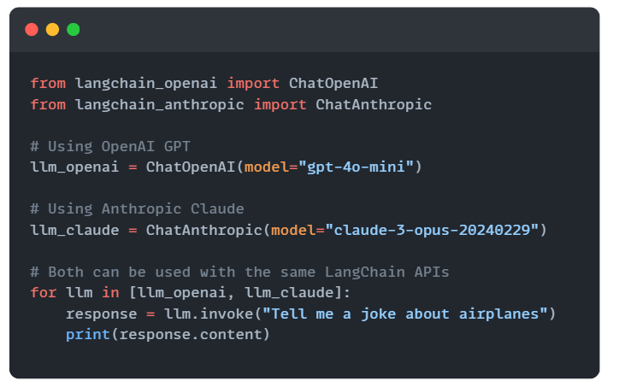
Unified Interface for LLMs
Notes:
Example objectives
At the end of this lesson, you will be able to:
Save files to the team Web server.
Move files to different locations on the team Web server.
Share files on the team Web server.

Slide 8
Let’s improve
Version 2
Notes:
Example objectives
At the end of this lesson, you will be able to:
Save files to the team Web server.
Move files to different locations on the team Web server.
Share files on the team Web server.

Slide 9
To read
https://python.langchain.com/docs/concepts/prompt_templates/
Notes:
Example objectives
At the end of this lesson, you will be able to:
Save files to the team Web server.
Move files to different locations on the team Web server.
Share files on the team Web server.

Slide 10
Your Friend: Your Bot Doesn’t remember
Sample Conversation
I need followup answers
User: I want to go to Dubai Mall
Bot: Okay, that a cool place to visit…
User: Does it have ice rink.
Bot: Yes…

Slide 11
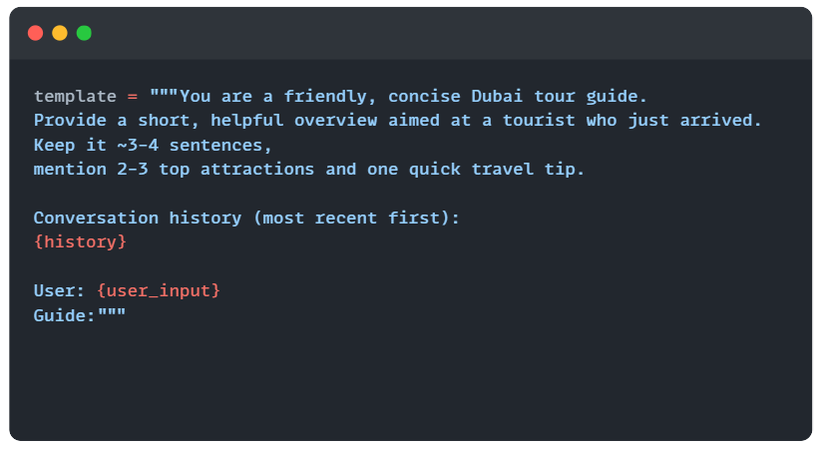
Trick : To pass recent history in Prompt

Slide 12
Let’s code it
Version 3
Notes:
Example objectives
At the end of this lesson, you will be able to:
Save files to the team Web server.
Move files to different locations on the team Web server.
Share files on the team Web server.

Slide 13
Can we improve?
Yes we can
ConversationBufferMemory
Notes:
Example objectives
At the end of this lesson, you will be able to:
Save files to the team Web server.
Move files to different locations on the team Web server.
Share files on the team Web server.

Slide 14
Let’s revisit
Version 3
Notes:
Example objectives
At the end of this lesson, you will be able to:
Save files to the team Web server.
Move files to different locations on the team Web server.
Share files on the team Web server.

Slide 15
To read
https://python.langchain.com/api_reference/langchain/memory/langchain.memory.buffer.ConversationBufferMemory.html
Notes:
Example objectives
At the end of this lesson, you will be able to:
Save files to the team Web server.
Move files to different locations on the team Web server.
Share files on the team Web server.

Slide 16
Your Friend: Can it tell me real weather?
Your friend was packing for the trip!
Solution: Langchain Tools

Slide 17
Let’s code it
Version 4
Notes:
Example objectives
At the end of this lesson, you will be able to:
Save files to the team Web server.
Move files to different locations on the team Web server.
Share files on the team Web server.

Slide 18
To read
https://python.langchain.com/docs/concepts/agents/
https://python.langchain.com/docs/concepts/tools/
Notes:
Example objectives
At the end of this lesson, you will be able to:
Save files to the team Web server.
Move files to different locations on the team Web server.
Share files on the team Web server.

Slide 19
Available tools
https://python.langchain.com/docs/integrations/tools/
Notes:
Example objectives
At the end of this lesson, you will be able to:
Save files to the team Web server.
Move files to different locations on the team Web server.
Share files on the team Web server.

Slide 20
Monitoring
Any better way to trace the LLM Calls?

Slide 21
Let’s code it
Version 5
Notes:
Example objectives
At the end of this lesson, you will be able to:
Save files to the team Web server.
Move files to different locations on the team Web server.
Share files on the team Web server.

Slide 22
Deployment using LangServe
Let’s see

Slide 23
Let’s code it
Version 5
Notes:
Example objectives
At the end of this lesson, you will be able to:
Save files to the team Web server.
Move files to different locations on the team Web server.
Share files on the team Web server.

Slide 24
Summary
Why Langchain
AI Chatbot
Prompts & LLMs
Simplify Prompts with PromptTemplate
Tools
Adding Weather Capabilities using Tools
Remember with ConversationBufferMemory
Memory
Observability
Monitor
using
LangSmith
Deployment
Deploy using LangServe

Slide 25
Thankyou

